Slide 1

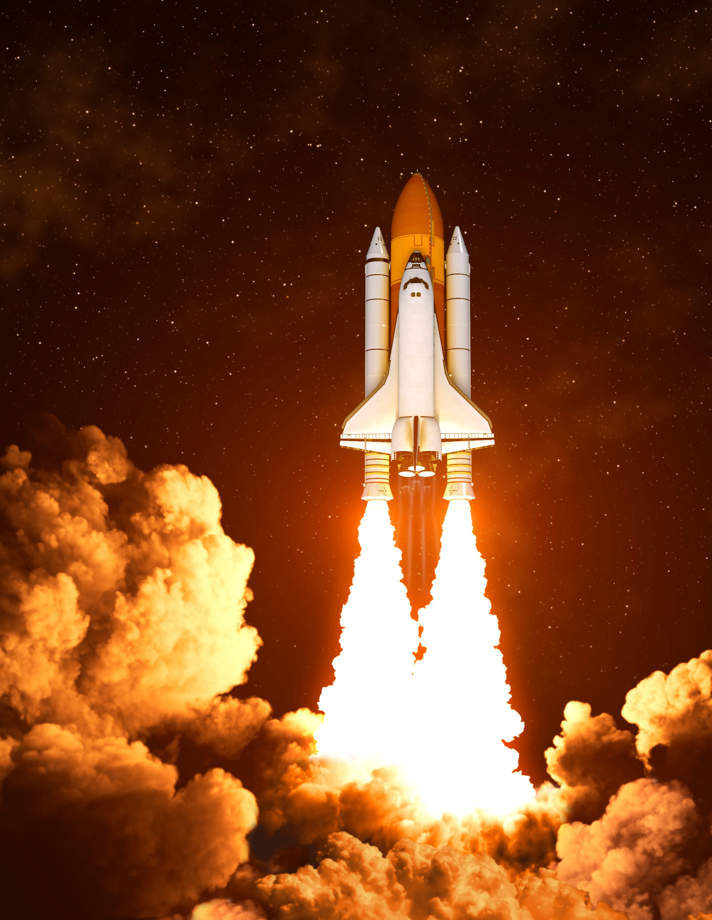

Winning Space Race with Data Science
Supervisor : Dr. Muhammad Hanif
Co-Supervisor : Mr. Ibad Ullah
Hazrat abbas khan
abbaskhan0345060@gamail.com
abbaskhan0345 (GitHub)
Riphah Institute of Informatics

Slide 2








Table of Content
Executive Summary
Introduction and Background
Problem Statement
Proposed Solution & Methodology
Results
Conclusion
Appendix
Questions and Answers

Slide 3

Executive Summary

Slide 4
Executive Summary
Objective:
How to win the space race by using Data Science
Methodology:
Data collection
EDA
Visualization
Predictive Analysis
Conclusion
By Predive Analysis we train a model to see whether a rocket1st stage will land back successfully or not for a given parameters.

Slide 5


INTRODUCTION AND BACKGROUND

Slide 6

INTRODUCTION AND BACKGROUND
The traditional space race is about to launch a rocket and send it to space with no hope of reusability.
Us Space-Y and our competitor Space-X took initiative to change that approach with the reusability of rocket’s first stage.
Rocket is launch deliver the payload and the fist stage come back successfully. Which save cost and recycling of that Rocket.
The Rocket type that is used in this specific task is Falcon9.

Slide 7
Section 1

Slide 8

Problem Statement

Slide 9

Problem
The real problem we are facing is the unsuccessful land of the rocket’s 1st stage to the station.
To find how to predict that with some parameter our rocket’s 1st stage will land successful or not.

Slide 10

Proposed Solution & Methodology

Slide 11

Solution
A predative machine learning model which is train on past data from Space-X.
The model will inform us with the probability of success or not.

Slide 12
Methodology (Executive Summary)
Data collection
From Space-X open API.
Data Wrangling
Data fetched from Wikipedia page and prosecced.
EDA
Performed the EDA on collected data by the help of SQL queries and Visualization.
Interactive dashboards
Perform interactive visual analytics using Folium on the launch sites and Plotly dash for interactive data visualization based on time.
Predictive Modeling
Train and evaluate the different classification models after the preprocessing of data.

Slide 13

Data Collection
Web scraping data from Wiki Pedia
Data collection is the process of gathering data from available sources. This data can be
structured, unstructured, or semi-structured. For this project, data was collected via
SpaceX API and Web scrapping Wiki pages for relevant launch data.

Slide 14

Data Collection SpaceX API
The data collection process began with api request call from https://api.spacexdata.com/v4
Where we collected relevant information such as:
From the rocket column we obtained the booster name.
From the launchpad we were like to know the name of the launch site being used, the logitude, and the latitude.
From the payload we gain the info of the mass of the payload and the orbit that it is going to.
From cores we get to learn the outcome of the landing, the type of the landing, number of flights with that core, whether gridfins were used, wheter the core is reused, wheter legs were used, the landing pad used, the block of the core which is a number used to seperate version of cores, the number of times this specific core has been reused, and the serial of the core.
All the data received is then being saved to a csv file.
Data-Science-Specialization-Coursera-/Applied Data Science Capstone/jupyter-labs-spacex-data-collection-api (1).ipynb at main · abbaskhan0345/Data-Science-Specialization-Coursera-

Slide 15
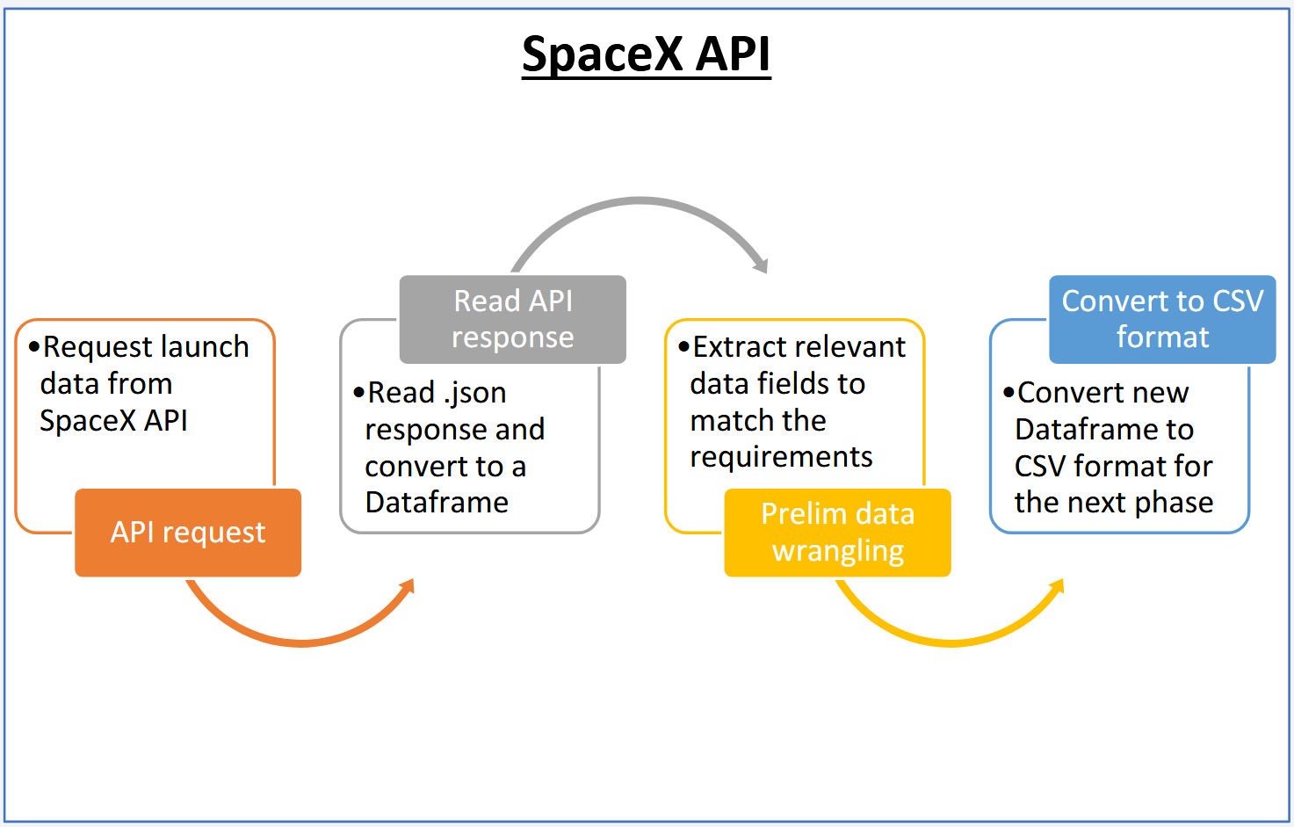
Data Collection SpaceX API

Slide 16
Data Collection - Scraping
Web scraping are done where we retrieved Falcon 9 and Falcon Heavy Launches Records from Wikipedia.
Web scraped Falcon 9 launch records with BeautifulSoup:
To Extract a Falcon 9 launch records HTML table from Wikipedia
To Parse the table and convert it into a Pandas data frame
Then saved the collected data into CSV
Data-Science-Specialization-Coursera-/Applied Data Science Capstone/jupyter-labs-webscraping (1).ipynb at main · abbaskhan0345/Data-Science-Specialization-Coursera-

Slide 17
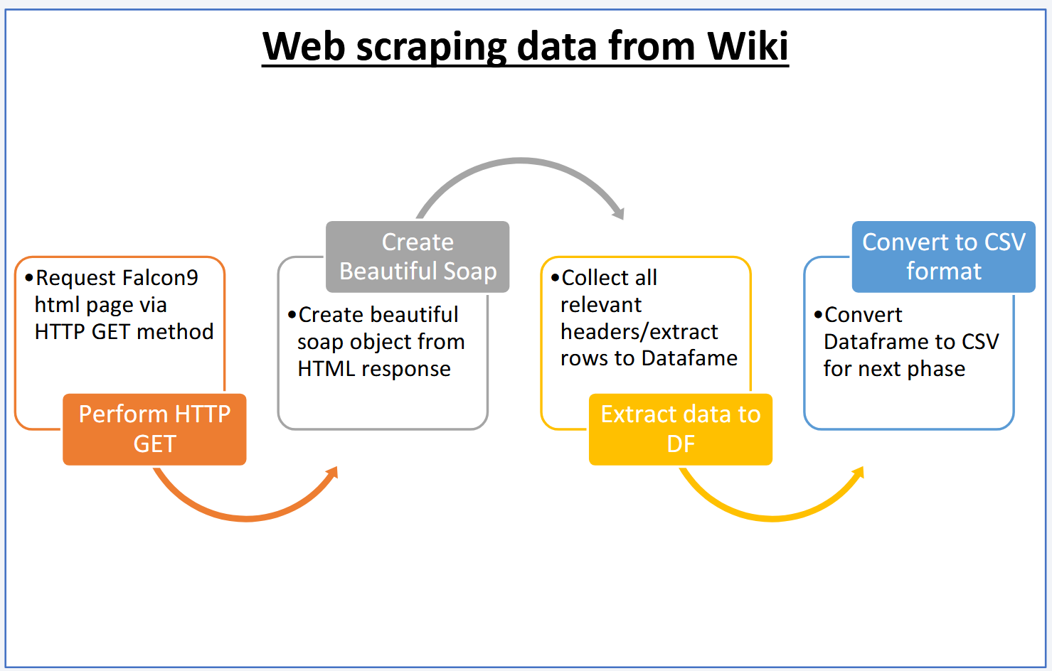
Data Collection - Scraping

Slide 18

Data Wrangling
In summary I Performed exploratory Data Analysis and determine Training Labels
Exploratory Data Analysis
Determine Training Labels
Data-Science-Specialization-Coursera-/Applied Data Science Capstone/labs-jupyter-spacex-Data wrangling.ipynb at main · abbaskhan0345/Data-Science-Specialization-Coursera-

Slide 19
Data Wrangling
Performed Data Analysis where:
Loaded the Space X dataset, from last section.
Identified null values
Identified and calculated the percentage of the missing values in each attribute
Identified which columns are numerical and categorical
Calculated the number of launches on each site
Calculate the number and occurrence of each orbit
Calculated the number and occurence of mission outcome of the orbits
Create a landing outcome label from Outcome column

Slide 20

EDA with Data Visualization
Perform exploratory Data Analysis and Feature Engineering using Pandas and Matplotlib
Exploratory Data Analysis
Preparing Data Feature Engineering
Data-Science-Specialization-Coursera-/Applied Data Science Capstone/edadataviz (2).ipynb at main · abbaskhan0345/Data-Science-Specialization-Coursera-

Slide 21
EDA with Data Visualization (Visualization)
Visualized the catplot for the relationship between Flight Number and Launch Site
Plotted the scatterplot to Visualize the relationship between Payload Mass and Launch Site
Bar chart were plotted to Visualize the relationship between success rate of each orbit type
Another scatter plot was used to Visualize the relationship between FlightNumber and Orbit type
3rd scatter plot for the Visualization of relationship between Payload Mass and Orbit type was used.
A line chart abilities was utilized to Visualize the launch success yearly trend.

Slide 22

EDA with Data Visualization (Feature engineering)
We obtain some preliminary insights about how each important variable would affect the success rate, we selected the features that will be used in success prediction in the future module.
Create dummy variables to categorical columns
Cast all numeric columns to float64
Feature engineered dataframe was saved to csv file

Slide 23

EDA with SQL
In EDA with sql I:
Understand the Spacex DataSet
Loaded the dataset into the corresponding table in a Db2 database
Executed SQL queries to answer relative questions about data
Data-Science-Specialization-Coursera-/Applied Data Science Capstone/jupyter-labs-eda-sql-coursera_sqllite.ipynb at main · abbaskhan0345/Data-Science-Specialization-Coursera-

Slide 24
EDA with SQL
The following steps were performed in EDA via SQL:
Downloaded the datasets
Connected to the database with sqlite3
Displayed the names of the unique launch sites in the space mission
Displayed 5 records where launch sites begin with the string 'CCA'
Displayed the total payload mass carried by boosters launched by NASA (CRS)
Displayed average payload mass carried by booster version F9 v1.1
Listed the date when the first succesful landing outcome in ground pad was acheived.
Listed the names of the boosters which have success in drone ship and have payload mass greater than 4000 but less than 6000
Listed the total number of successful and failure mission outcomes
Listed all the booster_versions that have carried the maximum payload mass, using a subquery with a suitable aggregate function.
List the records which will display the month names, failure landing_outcomes in drone ship ,booster versions, launch_site for the months in year 2015.
Rank the count of landing outcomes (such as Failure (drone ship) or Success (ground pad)) between the date 2010-06-04 and 2017-03-20, in descending order.

Slide 25

Build an Interactive Map with Folium
This lab contains the following tasks we have performed:
TASK 1: Mark all launch sites on a map
TASK 2: Mark the success/failed launches for each site on the map
TASK 3: Calculate the distances between a launch site to its proximities
After plotting the distance lines to the proximities, we answer the following questions easily:
Are launch sites in close proximity to railways? YES
Are launch sites in close proximity to highways? YES
Are launch sites in close proximity to coastline? YES
Do launch sites keep certain distance away from cities? YES
Data-Science-Specialization-Coursera-/Applied Data Science Capstone/lab_jupyter_launch_site_location.ipynb at main · abbaskhan0345/Data-Science-Specialization-Coursera-

Slide 26

Build a Dashboard with Plotly Dash
• Built a Plotly Dash web application to perform interactive visual analytics on SpaceX launch
data in real-time. Added Launch Site Drop-down, Pie Chart, Payload range slide, and a
Scatter chart to the Dashboard.
1. Added a Launch Site Drop-down Input component to the dashboard to provide an ability to filter
Dashboard visual by all launch sites or a particular launch site
2. Added a Pie Chart to the Dashboard to show total success launches when ‘All Sites’ is selected and
show success and failed counts when a particular site is selected
3. Added a Payload range slider to the Dashboard to easily select different payload ranges to identify
visual patterns
4. Added a Scatter chart to observe how payload may be correlated with mission outcomes for selected
site(s). The color-label Booster version on each scatter point provided missions outcomes with
different boosters
Data-Science-Specialization-Coursera-/Applied Data Science Capstone/spacex-dash-app.py at main · abbaskhan0345/Data-Science-Specialization-Coursera-

Slide 27

Build a Dashboard with Plotly Dash
• Dashboard helped answer following questions:
1. Which site has the largest successful launches? KSC LC-39A with 10
2. Which site has the highest launch success rate? KSC LC-39A with 76.9% success
3. Which payload range(s) has the highest launch success rate? 2000 – 5000 kg
4. Which payload range(s) has the lowest launch success rate? 0-2000 and 5500 - 7000
5. Which F9 Booster version (v1.0, v1.1, FT, B4, B5, etc.) has the highest launch success rate? FT

Slide 28
Predictive Analysis (Classification)
Performed exploratory Data Analysis and determine Training Labels
created a column for the class
Standardized the data
Split into training data and test data
-Finded best Hyperparameter for SVM, Classification Trees and Logistic Regression
Finded the method performs best using test data
Data-Science-Specialization-Coursera-/Applied Data Science Capstone/SpaceX_Machine Learning Prediction_Part_5.ipynb at main · abbaskhan0345/Data-Science-Specialization-Coursera-

Slide 29
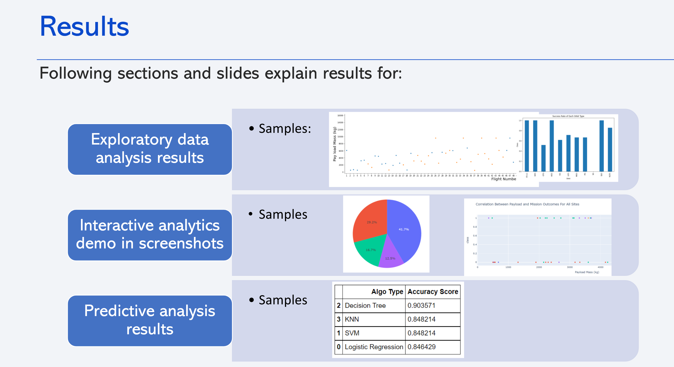

Slide 30

Inside Drawn from EDA

Slide 31
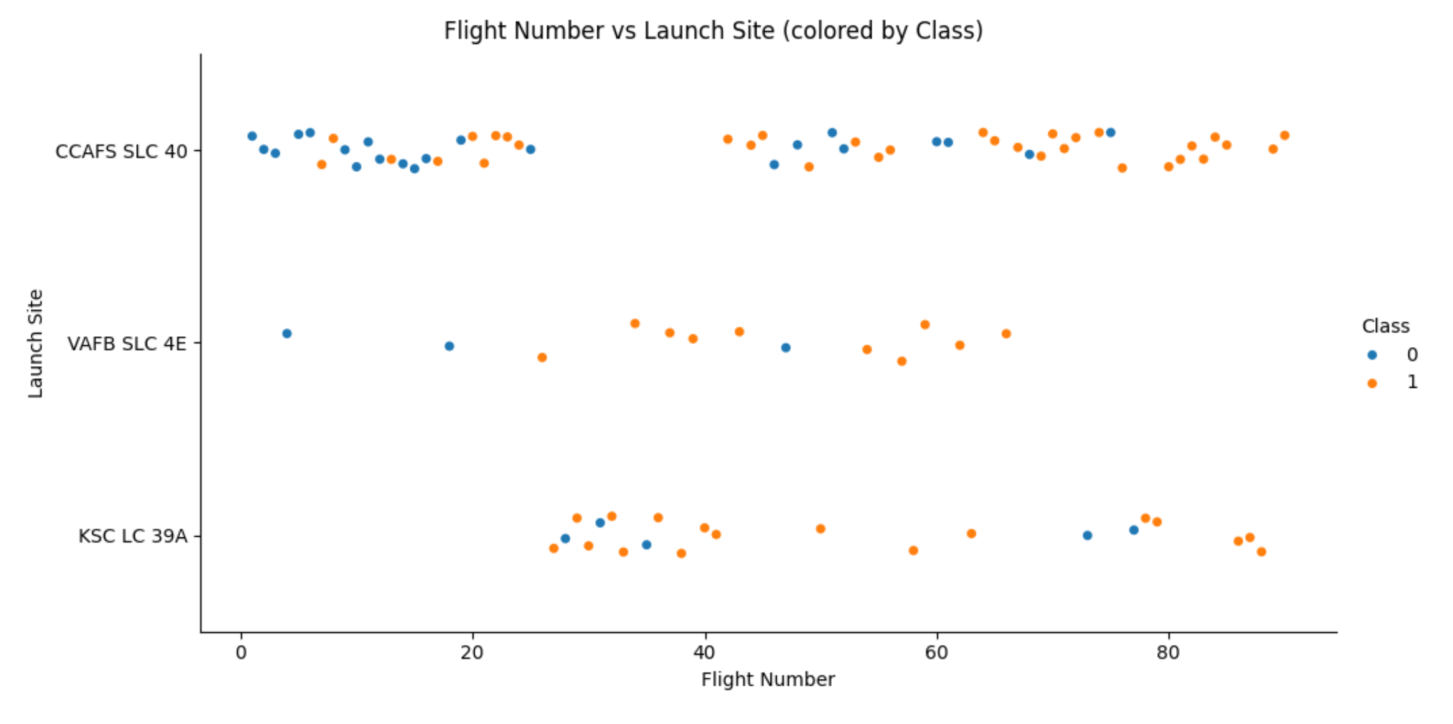
Flight Number vs. Launch Site
As we can see most of the flight are done from CCAFS SLC 40. With the approximately equal number of class 0 and 1.
For the least number of flight that are launch from VAFB SLC 4E. With only 3 class 0 and 9 class 1.
With the most successful the KSC LC 39A class 1 and less equal to 5 class 0.

Slide 32
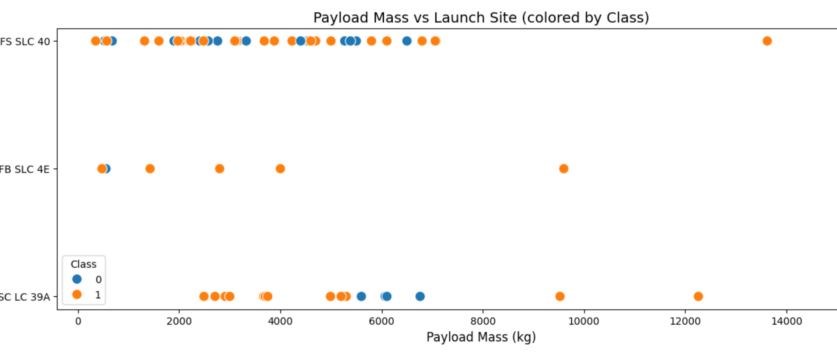
Payload vs. Launch Site
When the payload mass increases the chances of failure relatively increases. But that is not always the case.

Slide 33
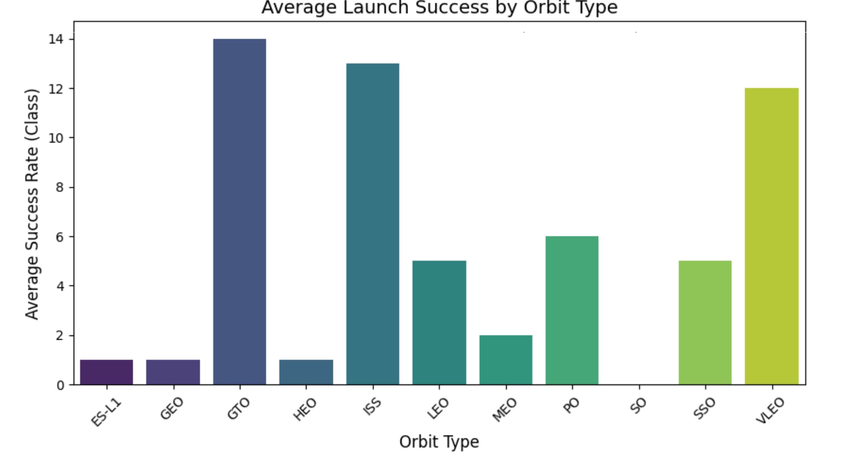
Success Rate vs. Orbit Type
The orbit also effect the success of the launch as we can see the GTO, ISS and VLEO has highest success rate while the ES-L1, GEO, HEO and SO has very little success rate.

Slide 34
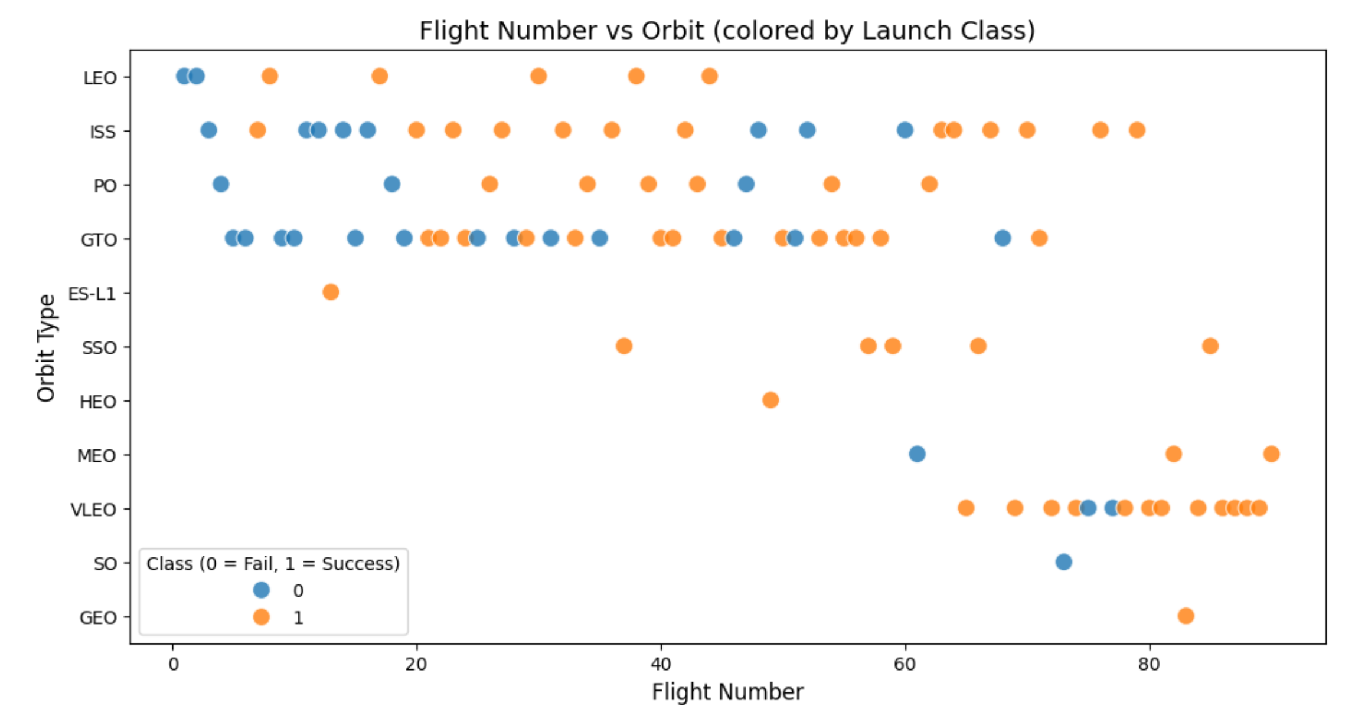
Flight Number vs. Orbit Type
The same effect of orbit type is can be seen the here in the following class.

Slide 35
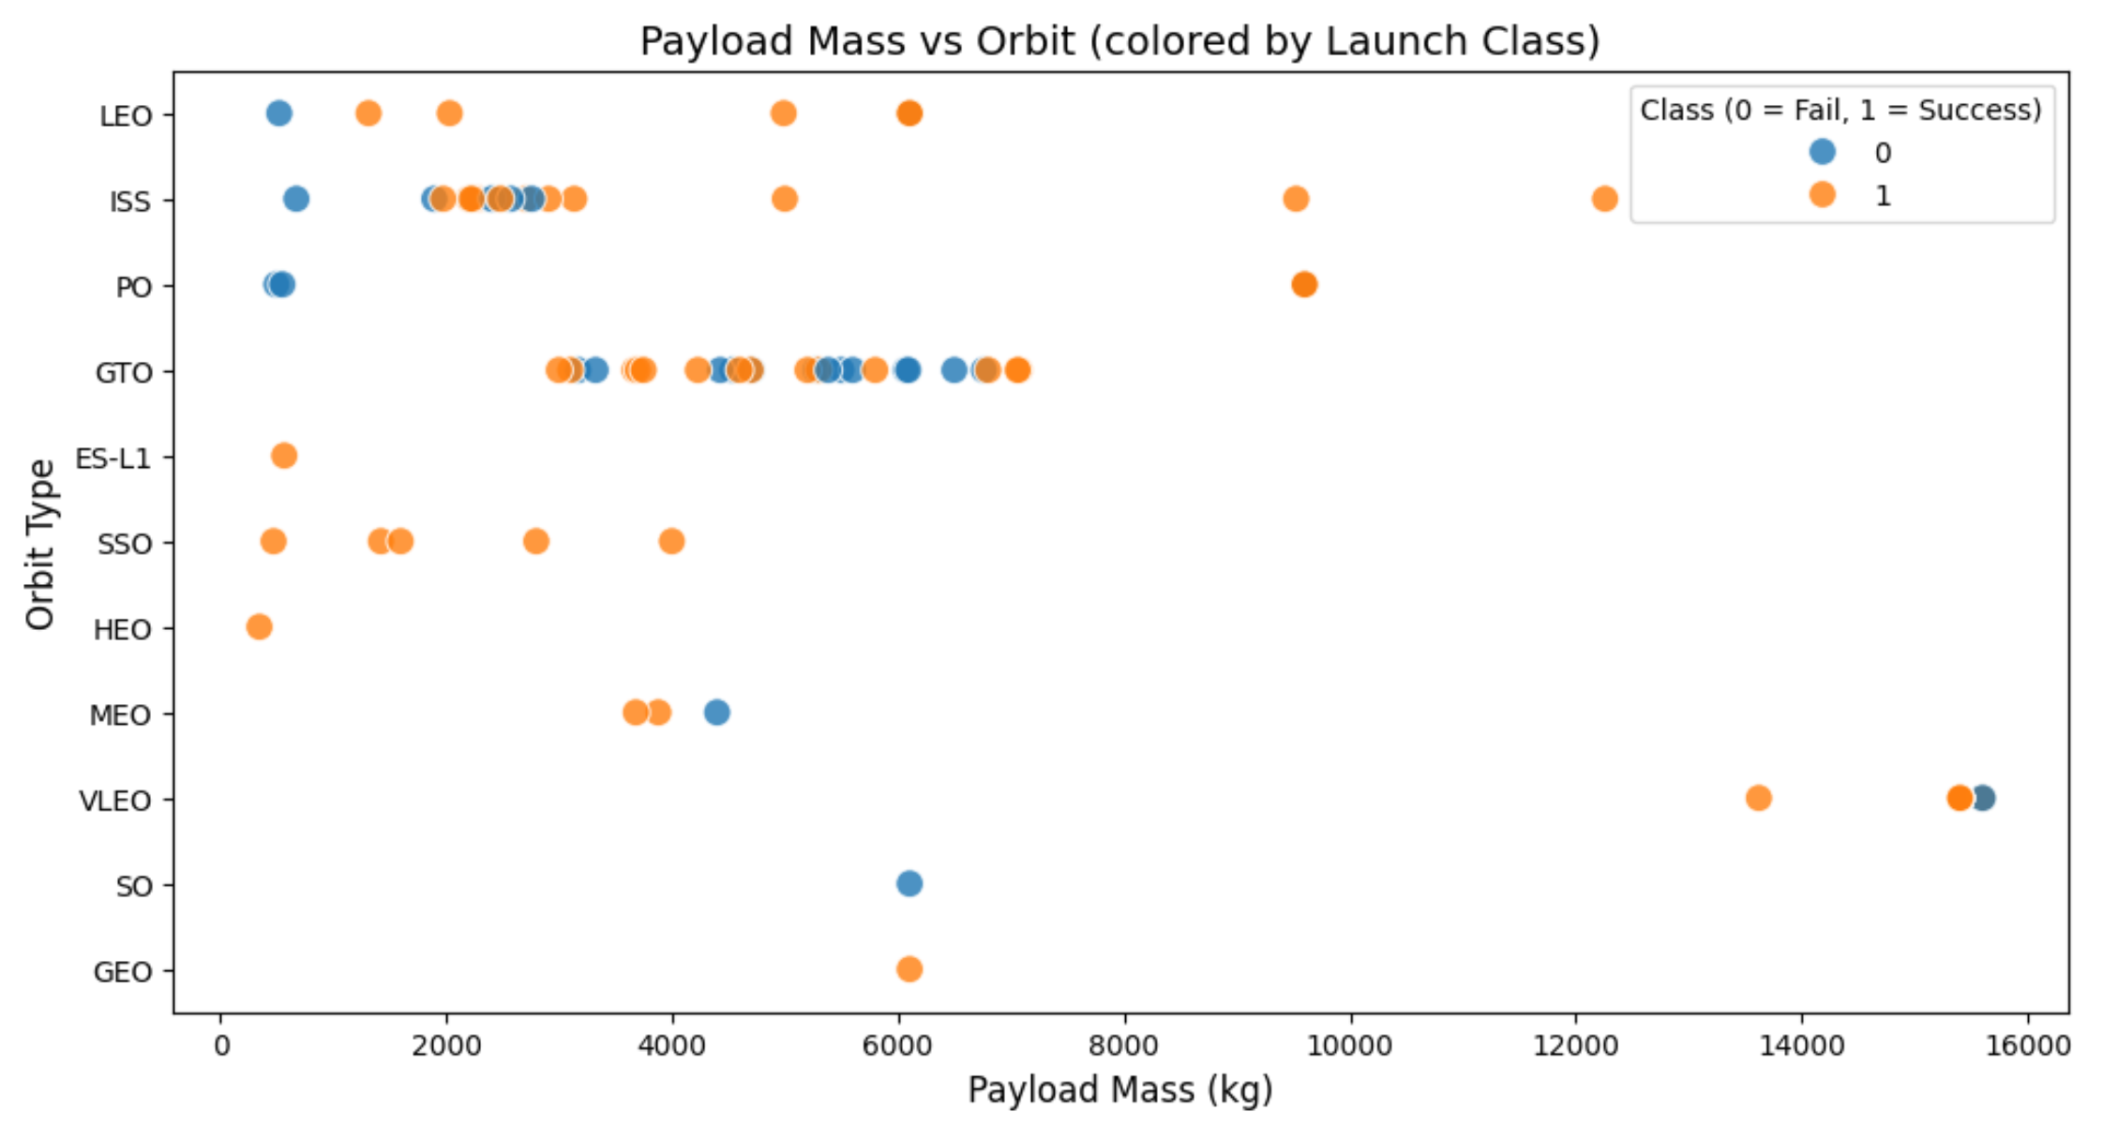
Payload vs. Orbit Type
The mass is different for every type of orbit for it successful.

Slide 36
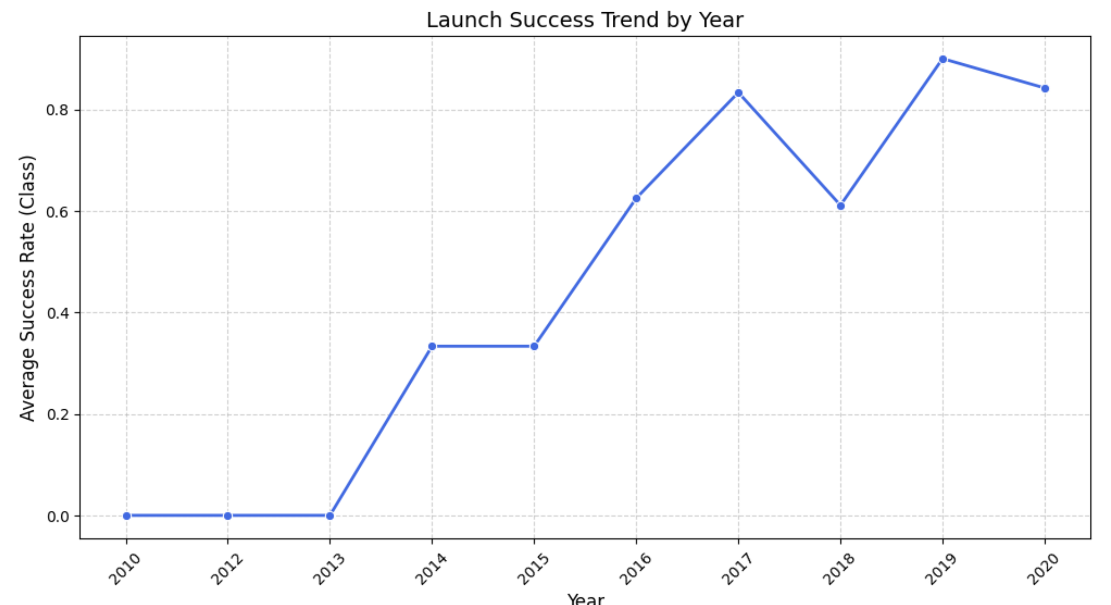
Launch Success Yearly Trend
As we can see that the success trend is going high with time.

Slide 37
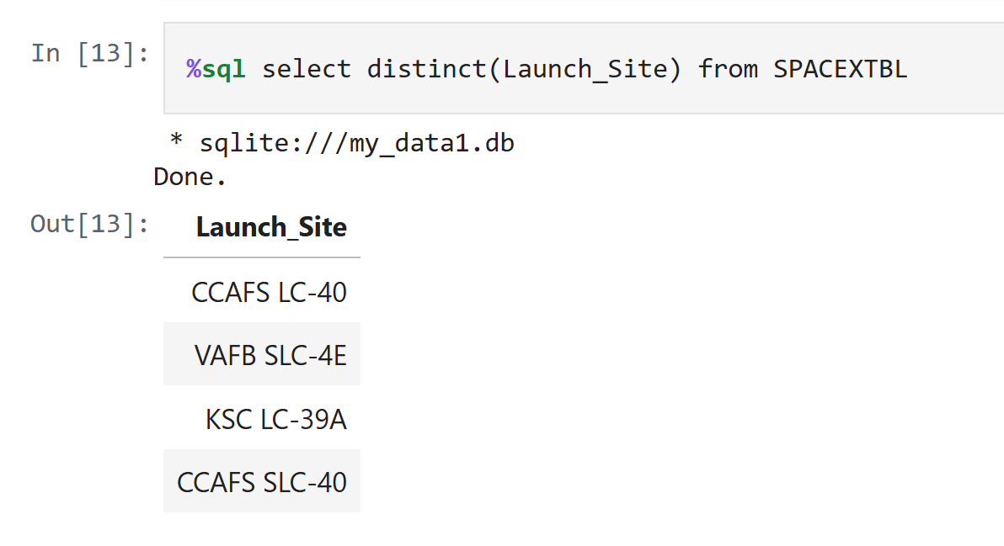
All Launch Site Names

Slide 38
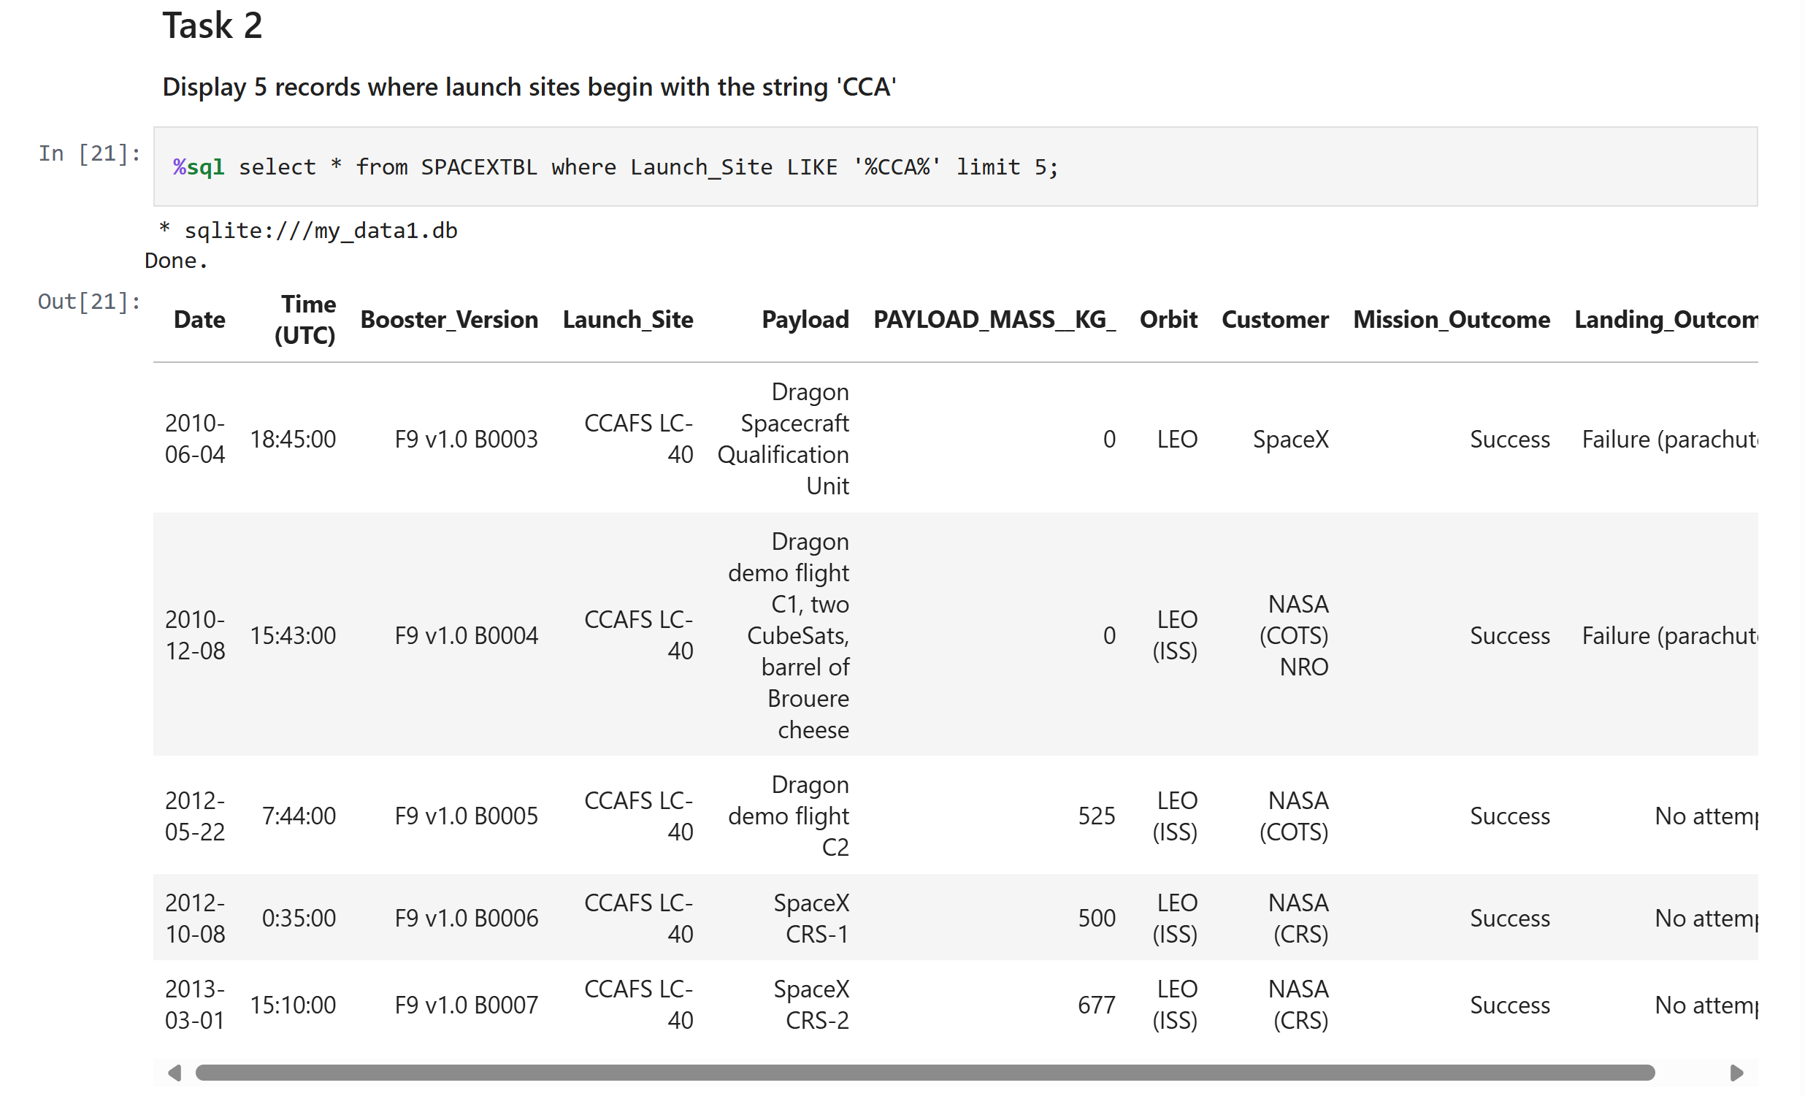
Launch Site Names Begin with 'CCA'

Slide 39
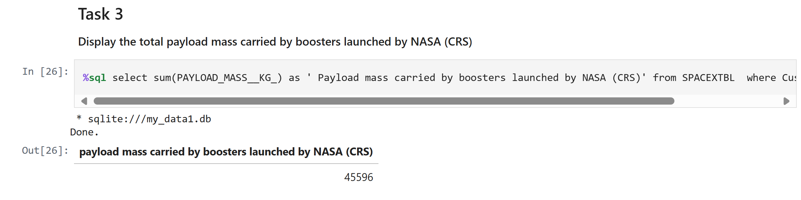
Total Payload Mass
%sql select sum(PAYLOAD_MASS__KG_) as ' Payload mass carried by boosters launched by NASA (CRS)' from SPACEXTBL where Customer = 'NASA (CRS)';

Slide 40
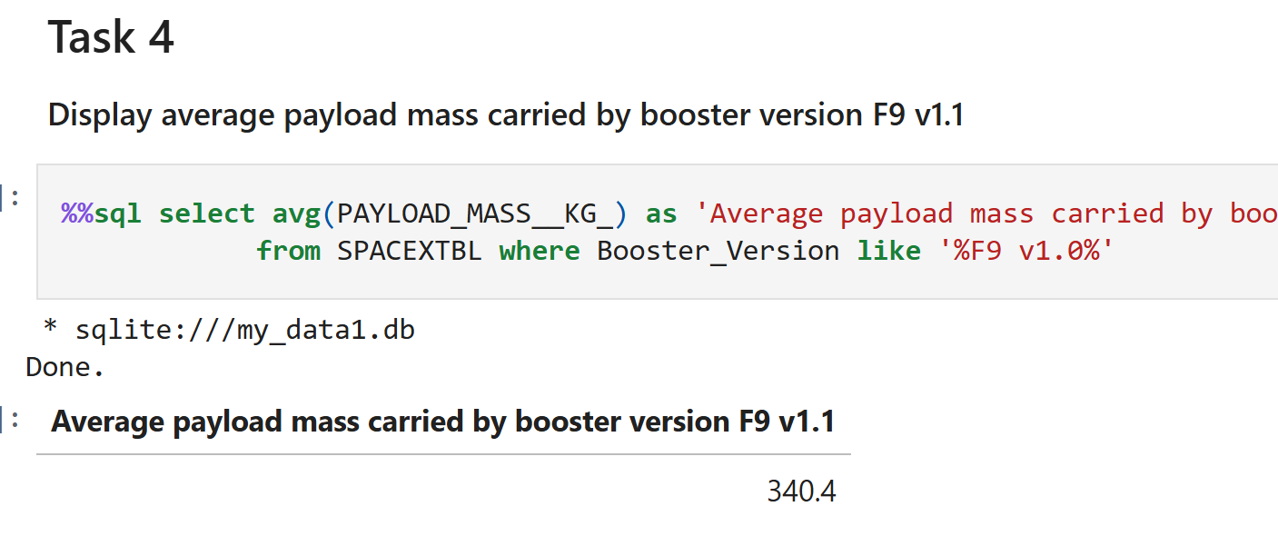
Average Payload Mass by F9 v1.1

Slide 41
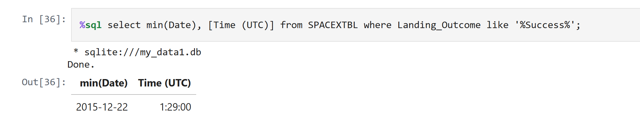
First Successful Ground Landing Date

Slide 42
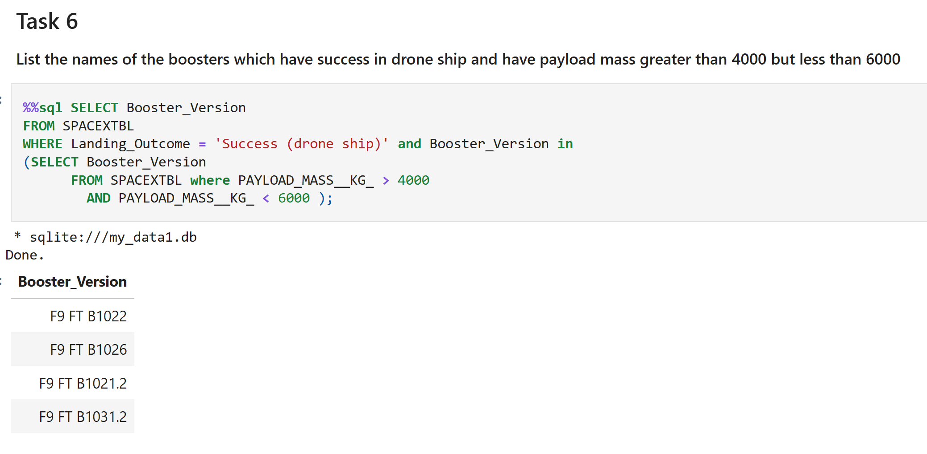
Successful Drone Ship Landing with Payload between 4000 and 6000

Slide 43
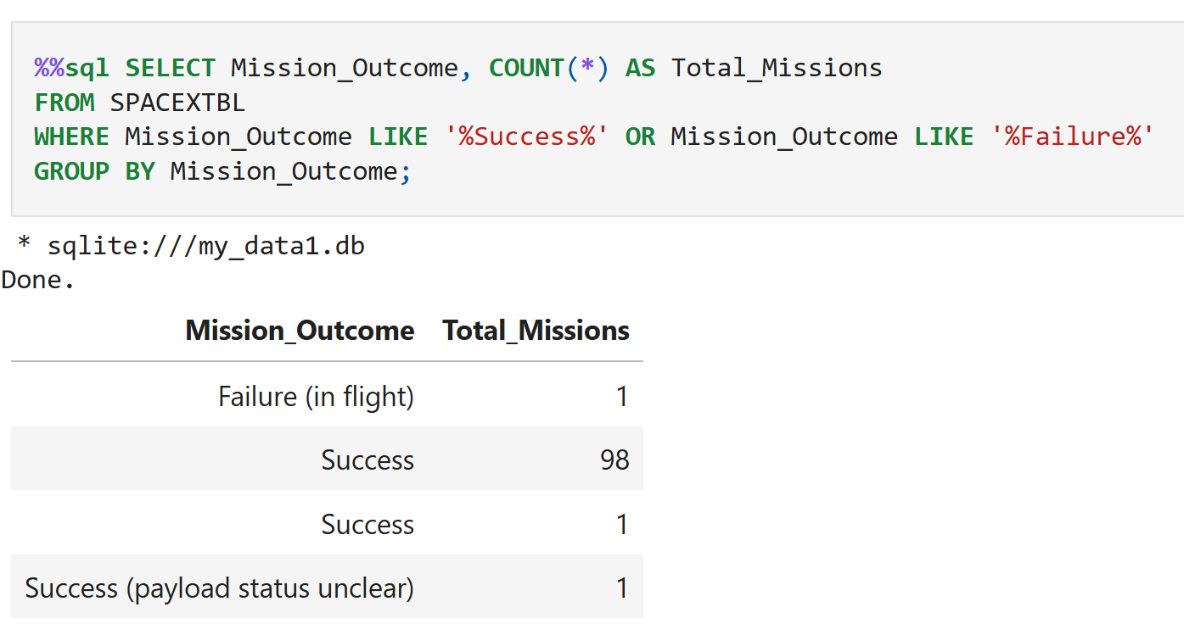
Total Number of Successful and Failure Mission Outcomes

Slide 44
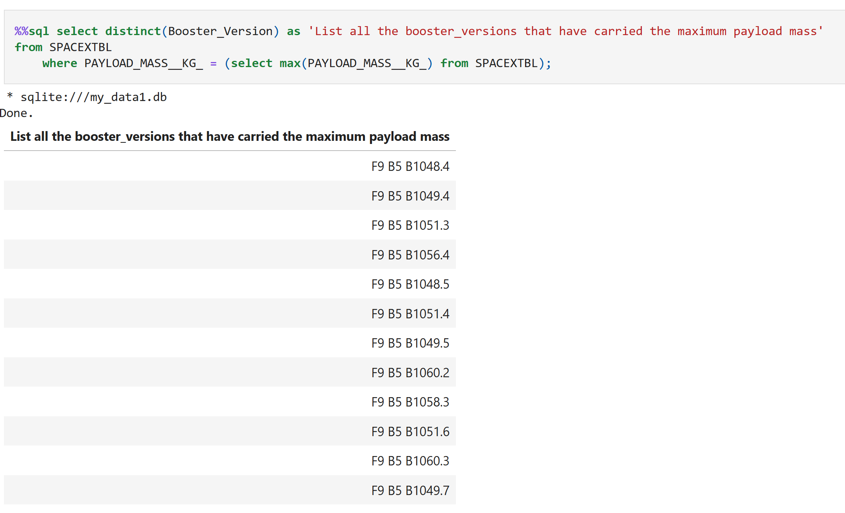
Boosters Carried Maximum Payload

Slide 45
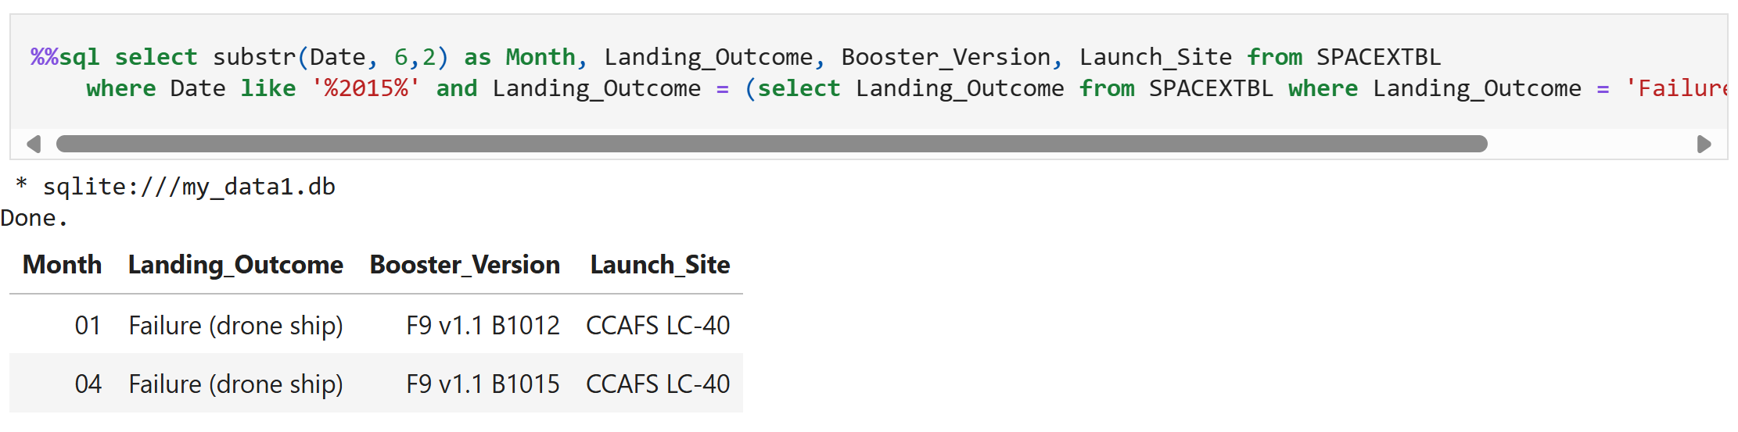
2015 Launch Records

Slide 46
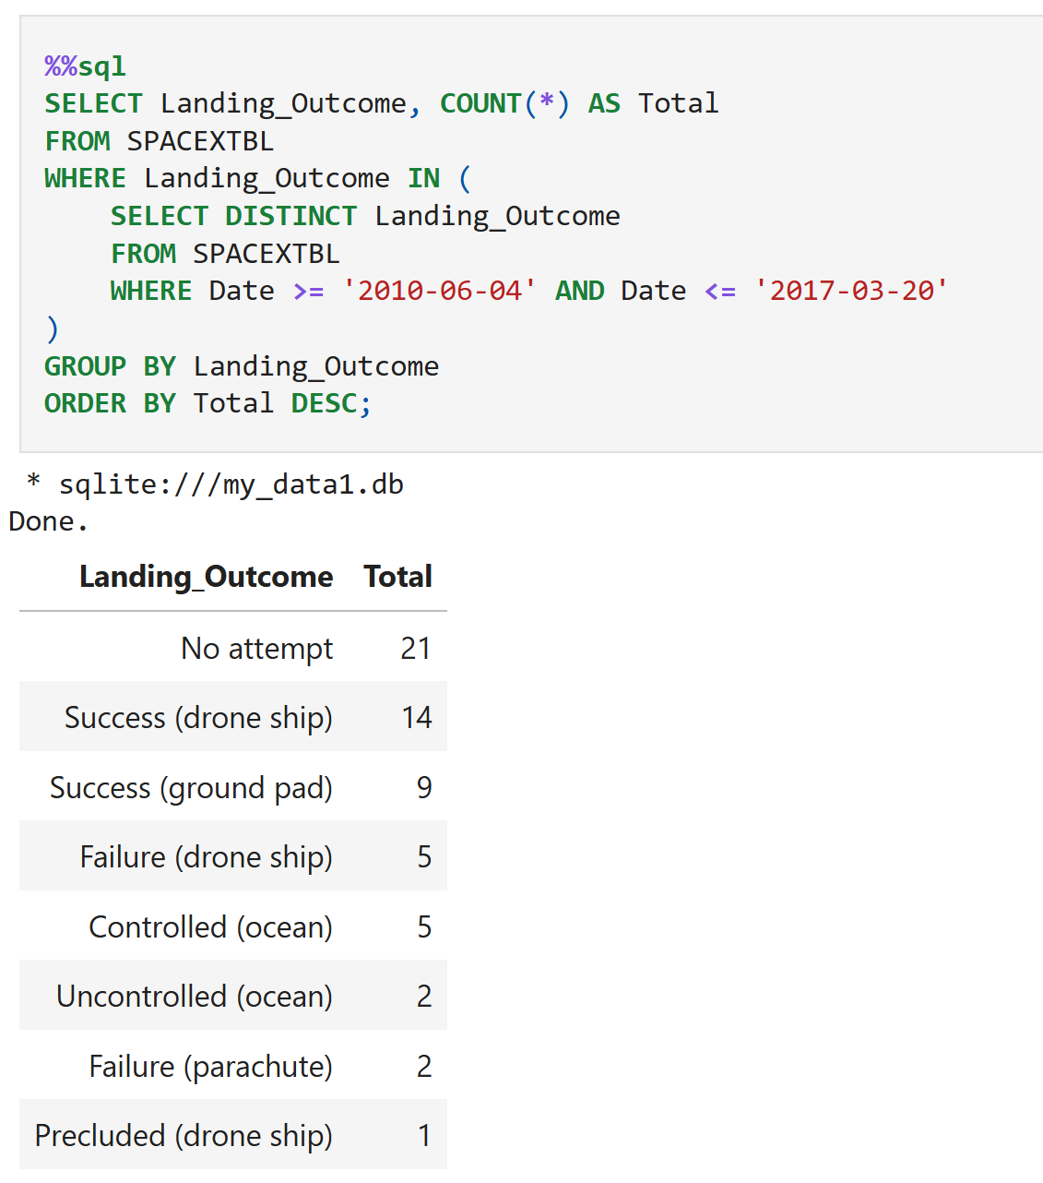
Rank Landing Outcomes Between 2010-06-04 and 2017-03-20

Slide 47

Rocket Launch Sites Proximities Analysis

Slide 48
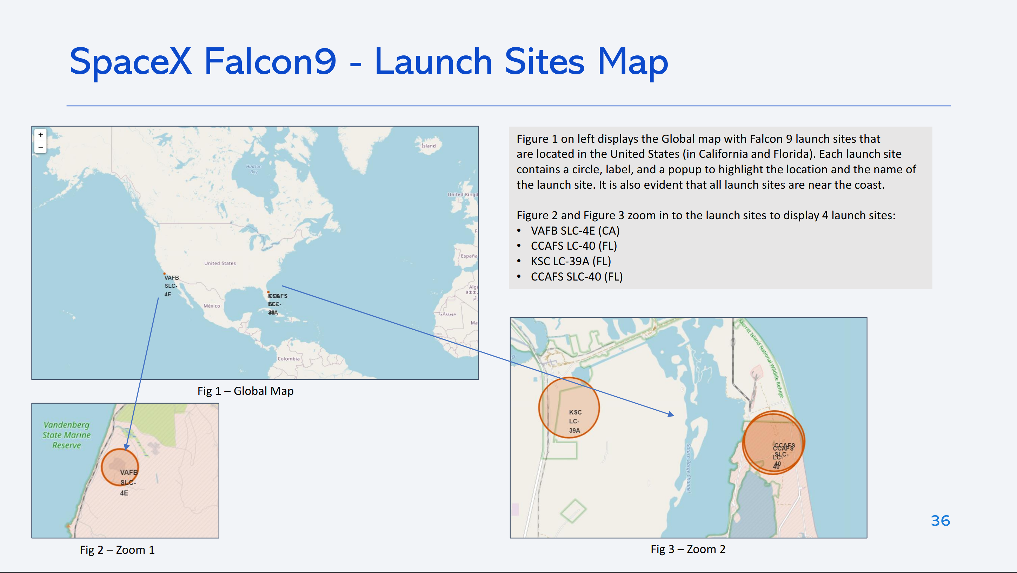

Slide 49
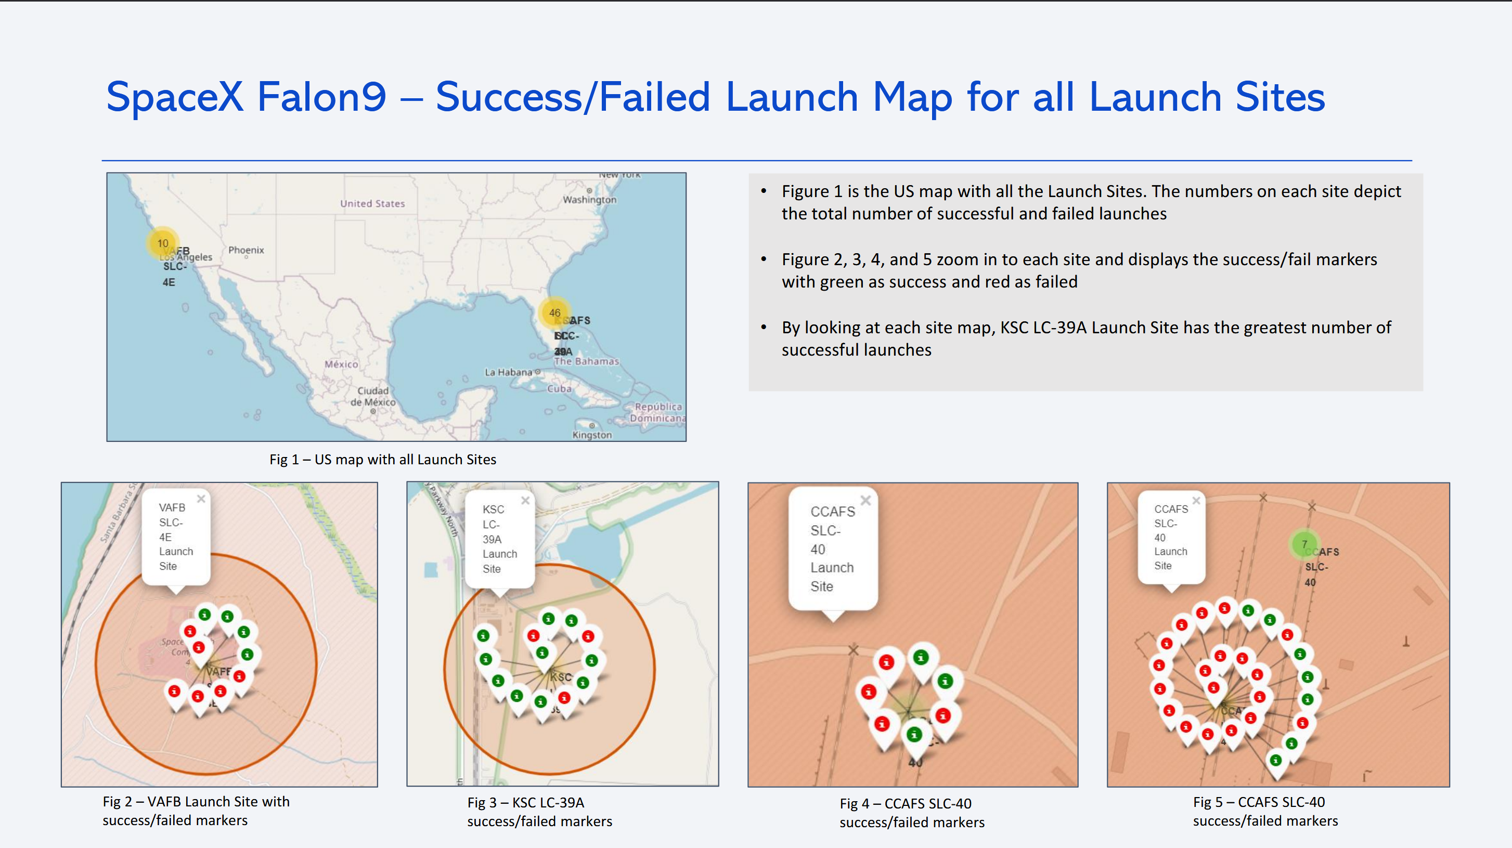

Slide 50
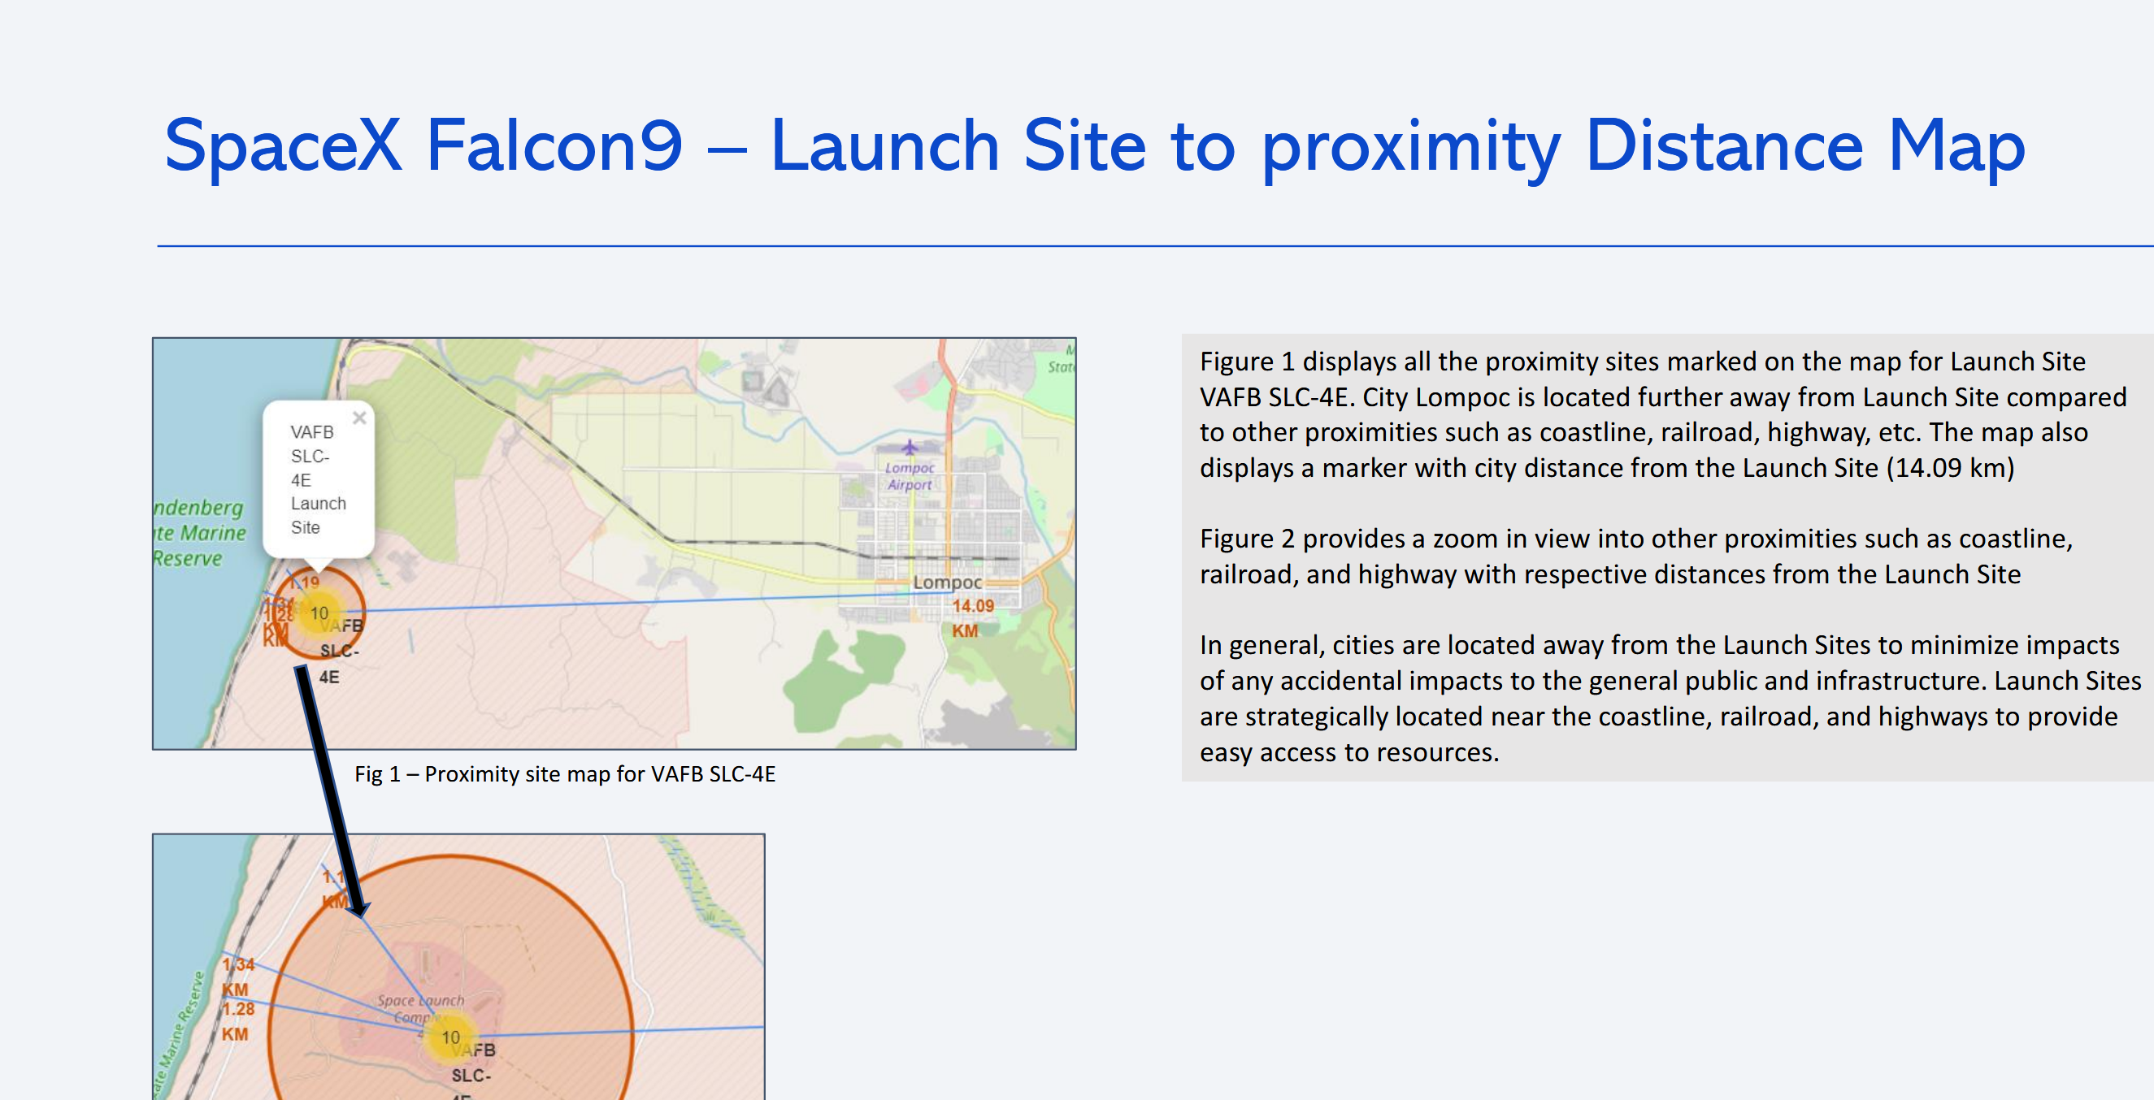

Slide 51

Build a Dashboard with Plotly Dash

Slide 52
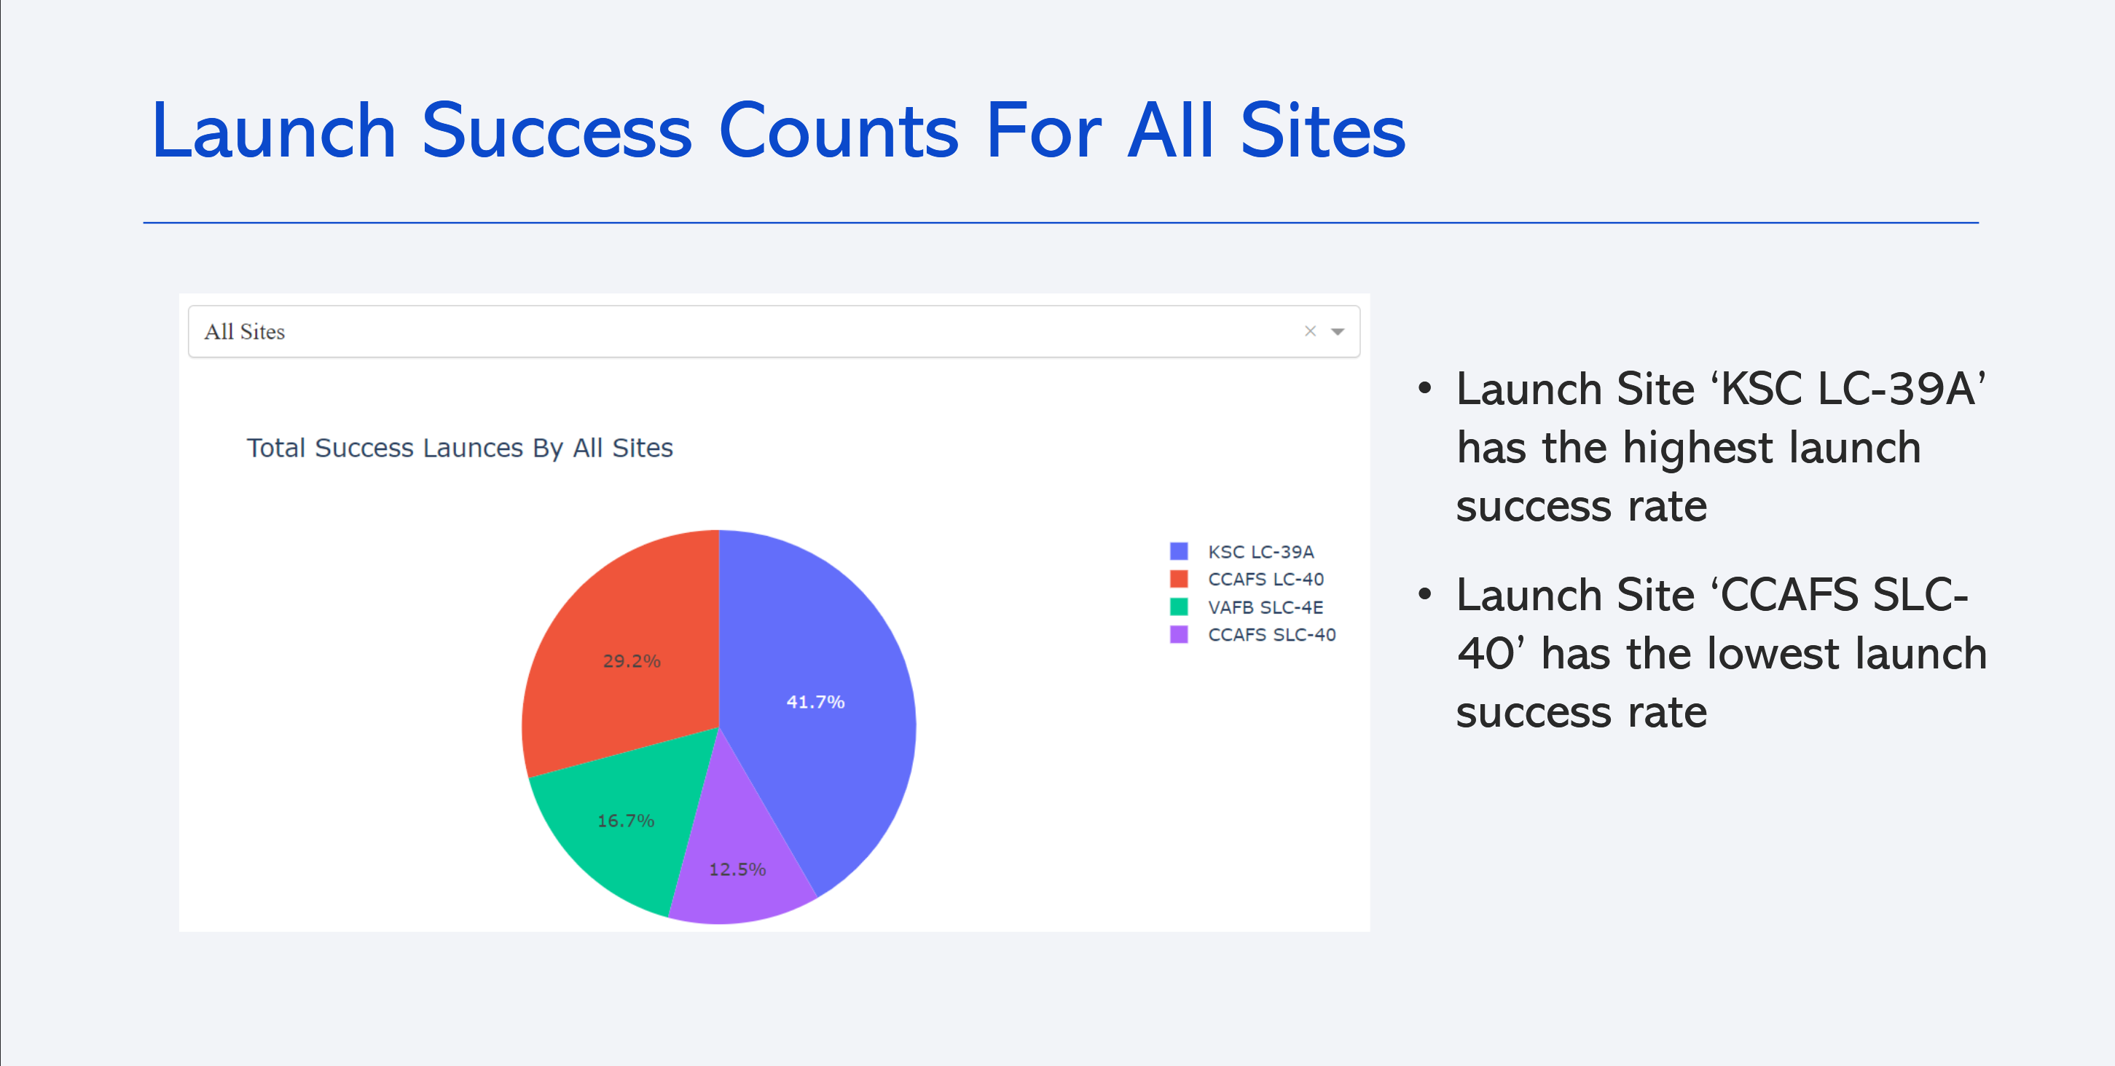

Slide 53
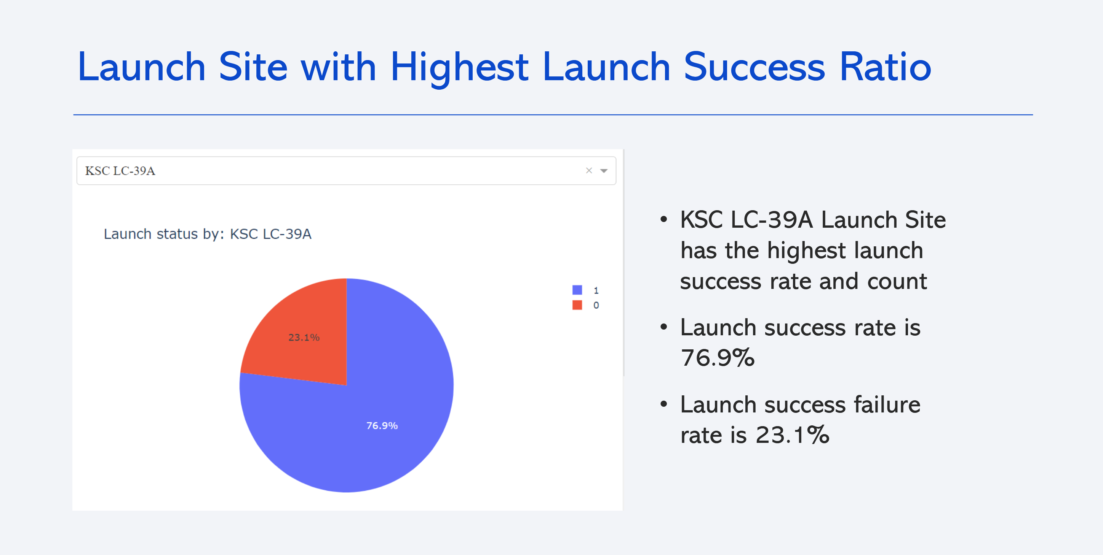

Slide 54
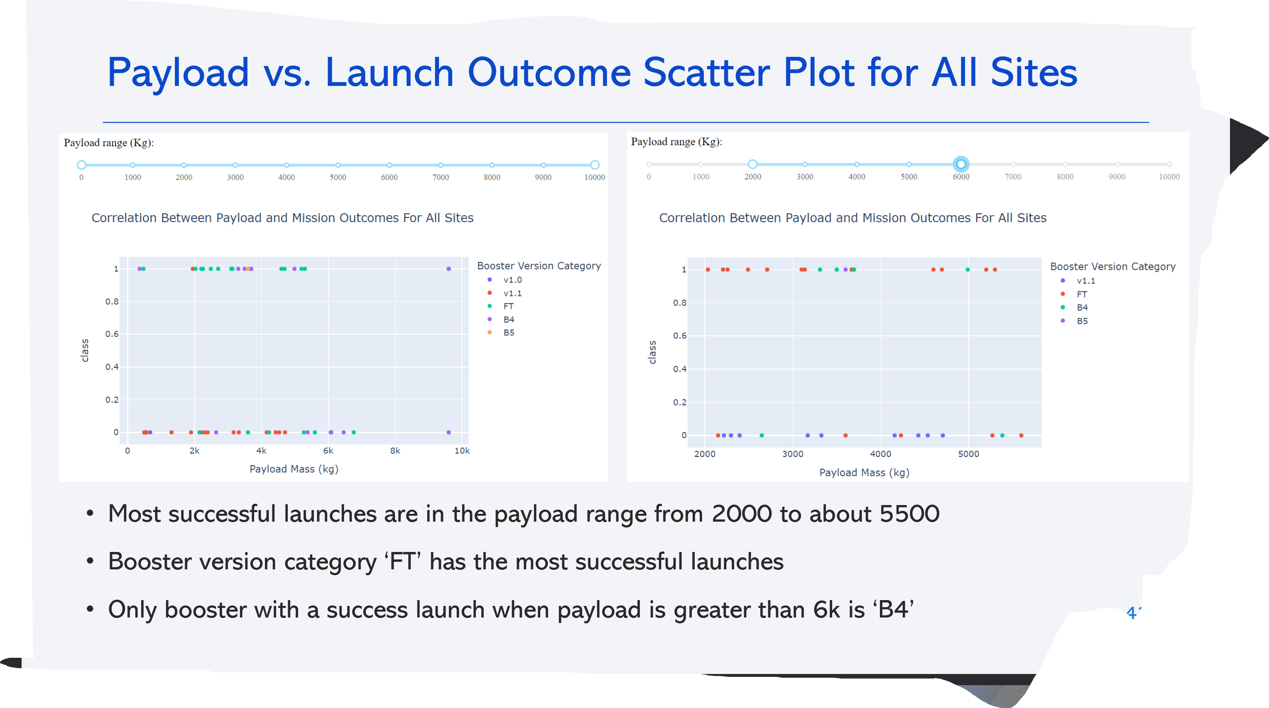

Slide 55
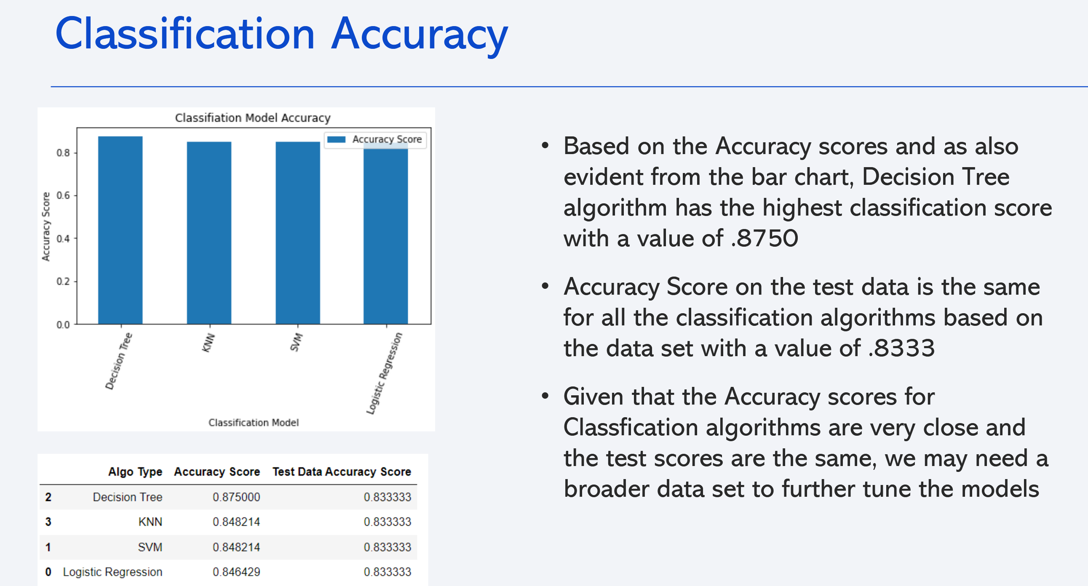

Slide 56
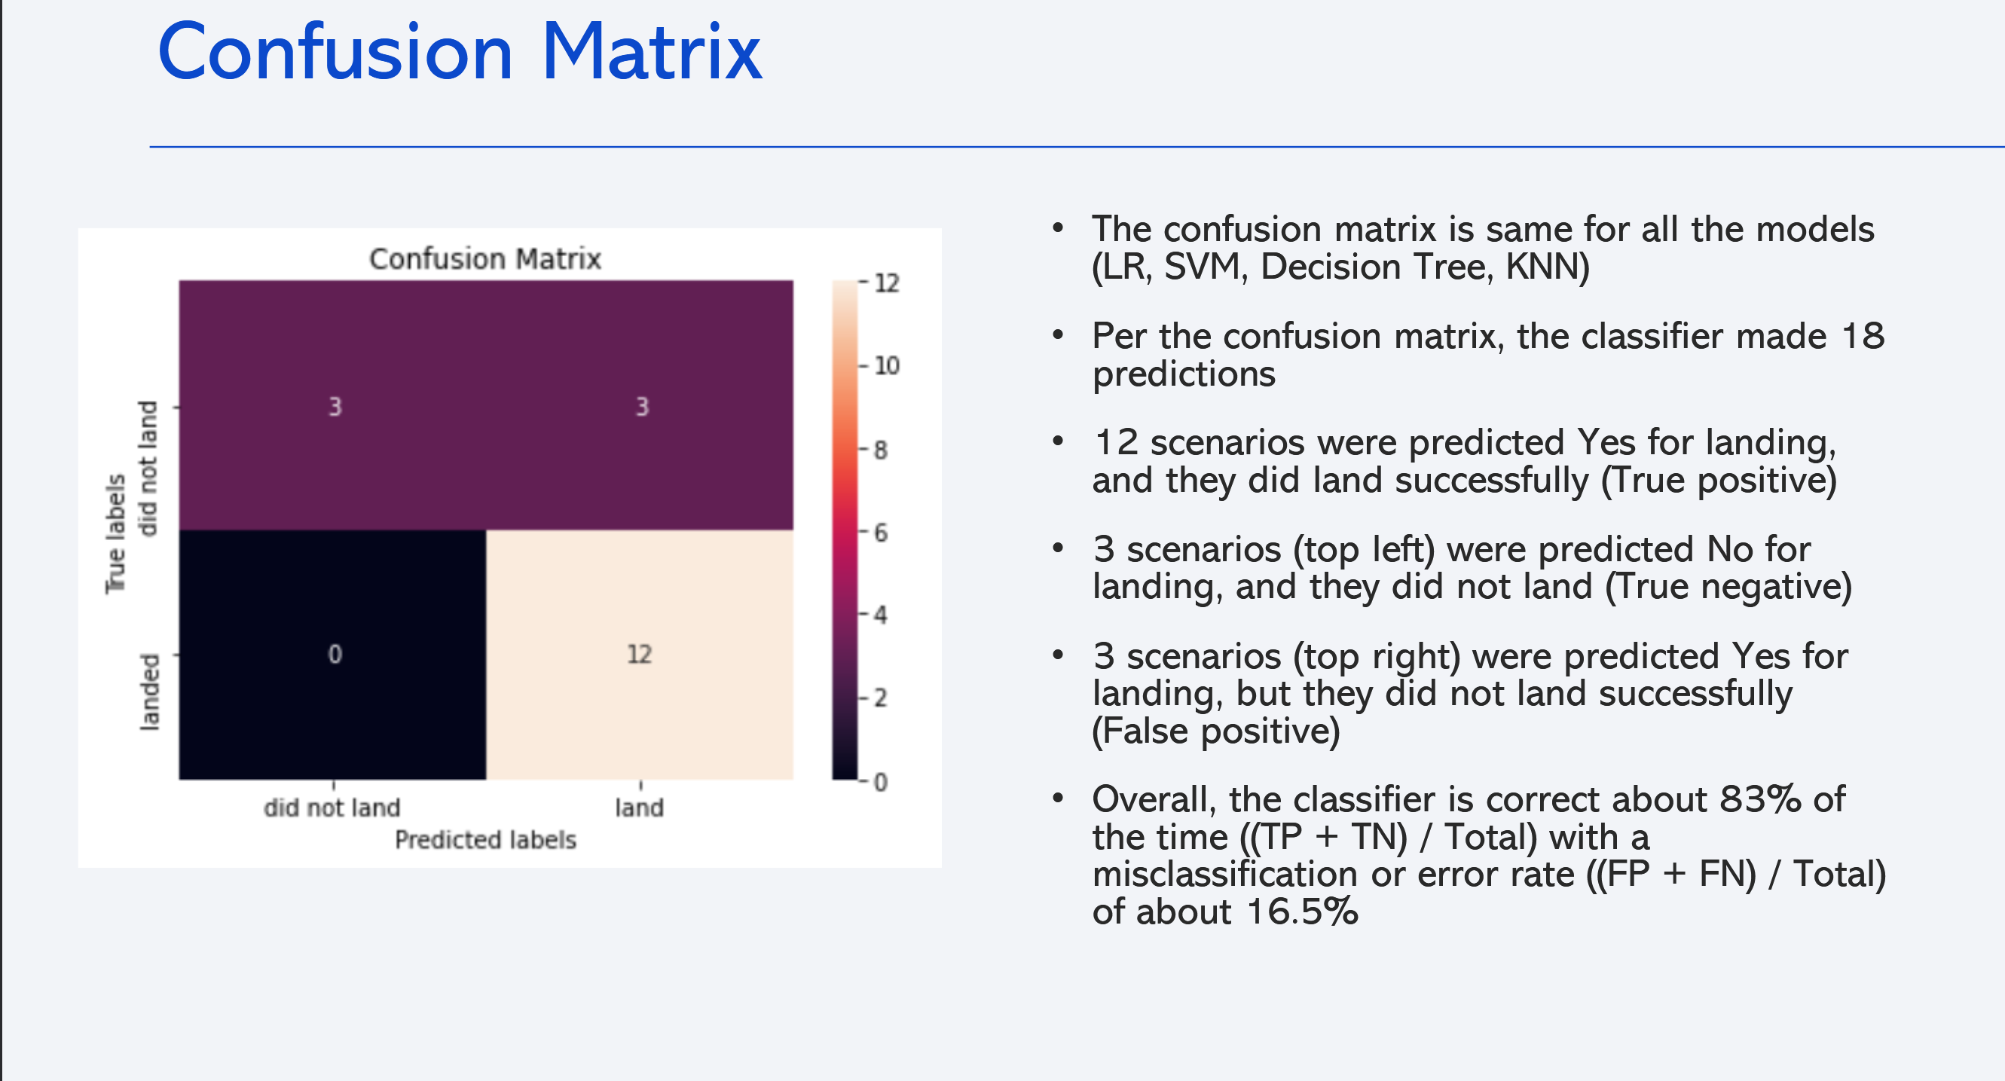

Slide 57
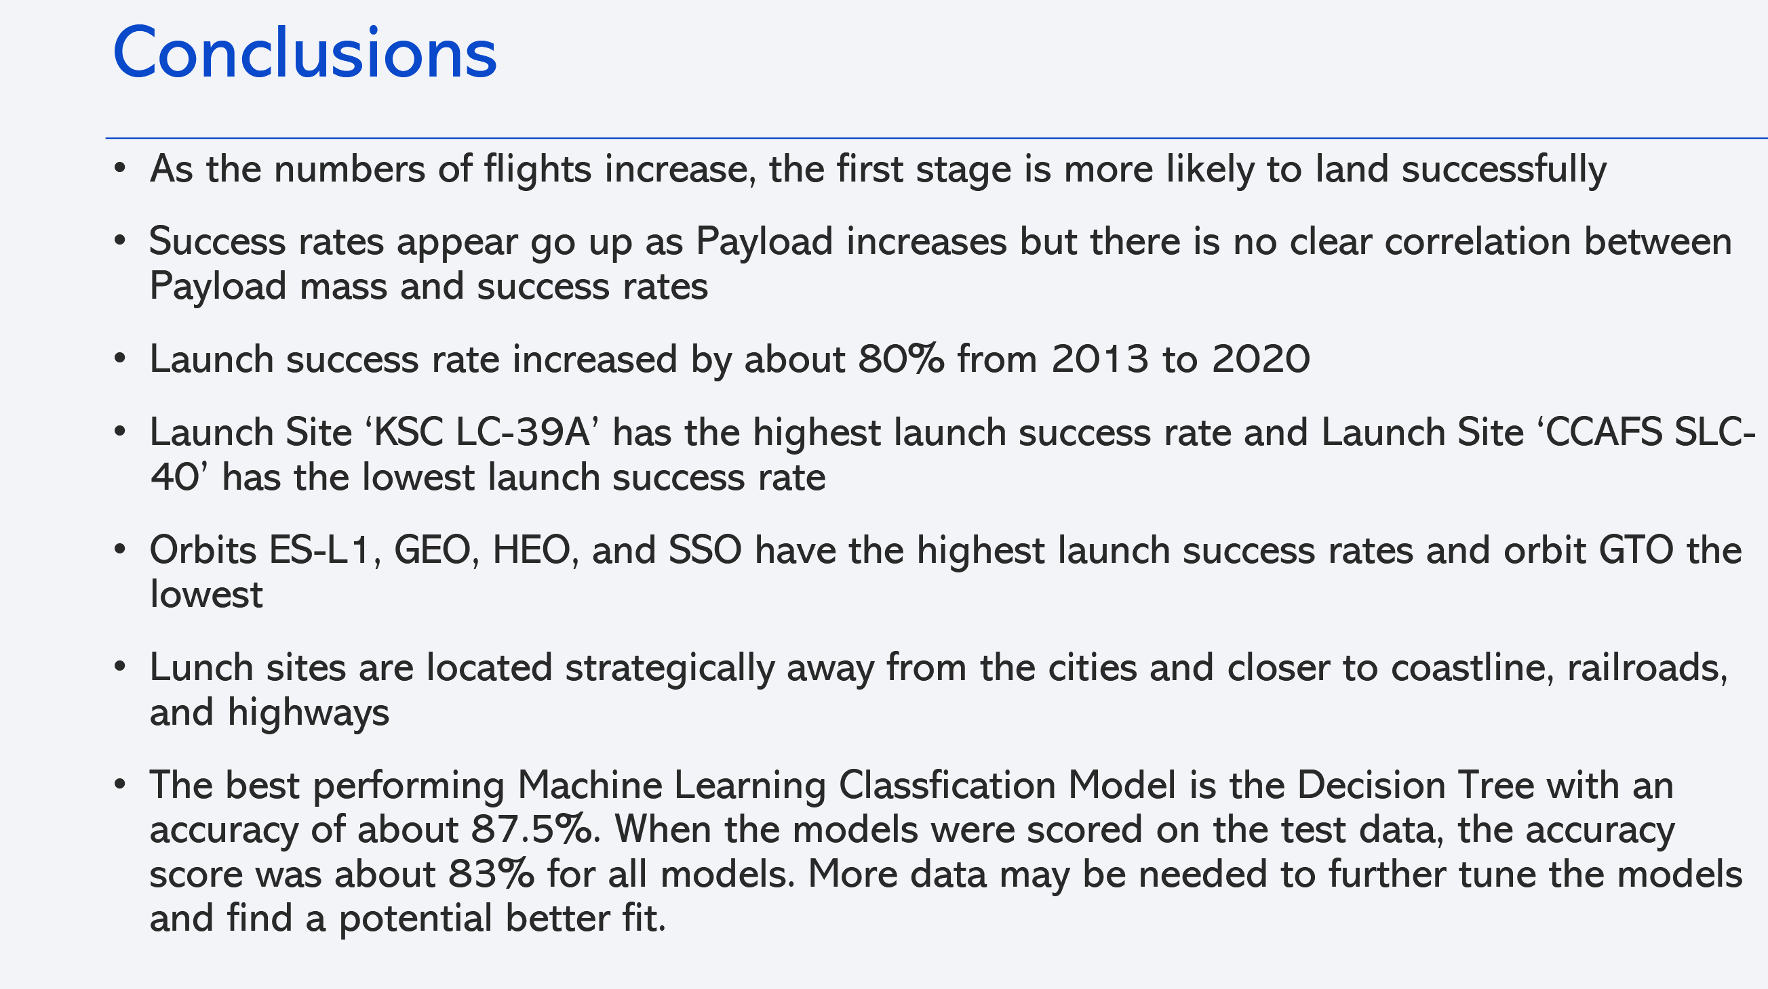

Slide 58
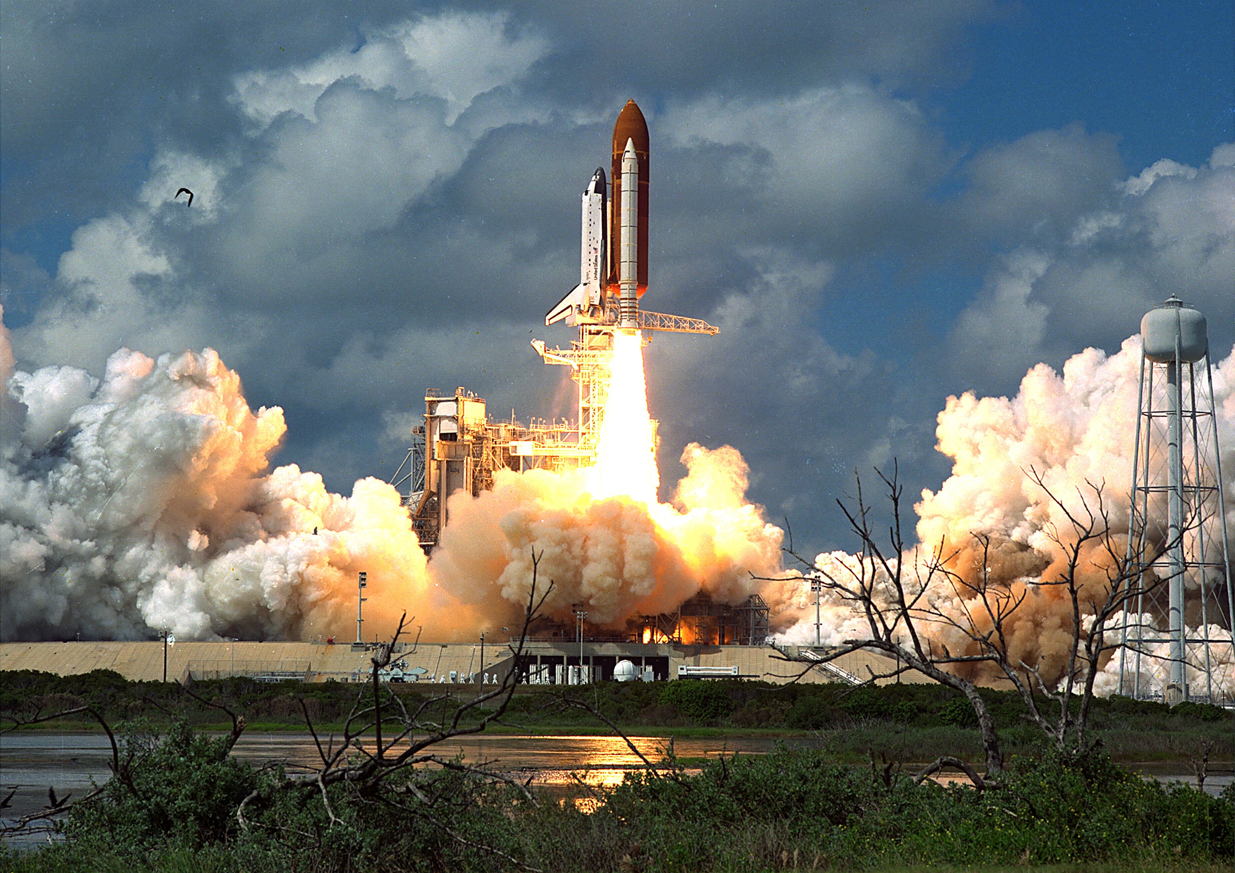
Thank you All for your Time.
Connect With me:
Linkedin: linkedin.com/in/hazrat-abbas-khan-113136329
Github: github.com/abbaskhan0345
Gmail: abbaskhan0345060@gmail.com

